Slide 1

Emmanuel Diaz Prof. Adam Bailey
CSD380 Mod9.2 Assignment

Slide 2

What is a Just Culture?
•A Just Culture focuses on creating an environment where mistakes are seen as learning opportunities, not reasons for blame.
•It’s about accountability, but with empathy balancing fairness and responsibility.
•In DevOps, it’s vital because trust and collaboration are the foundations of success.

Slide 3
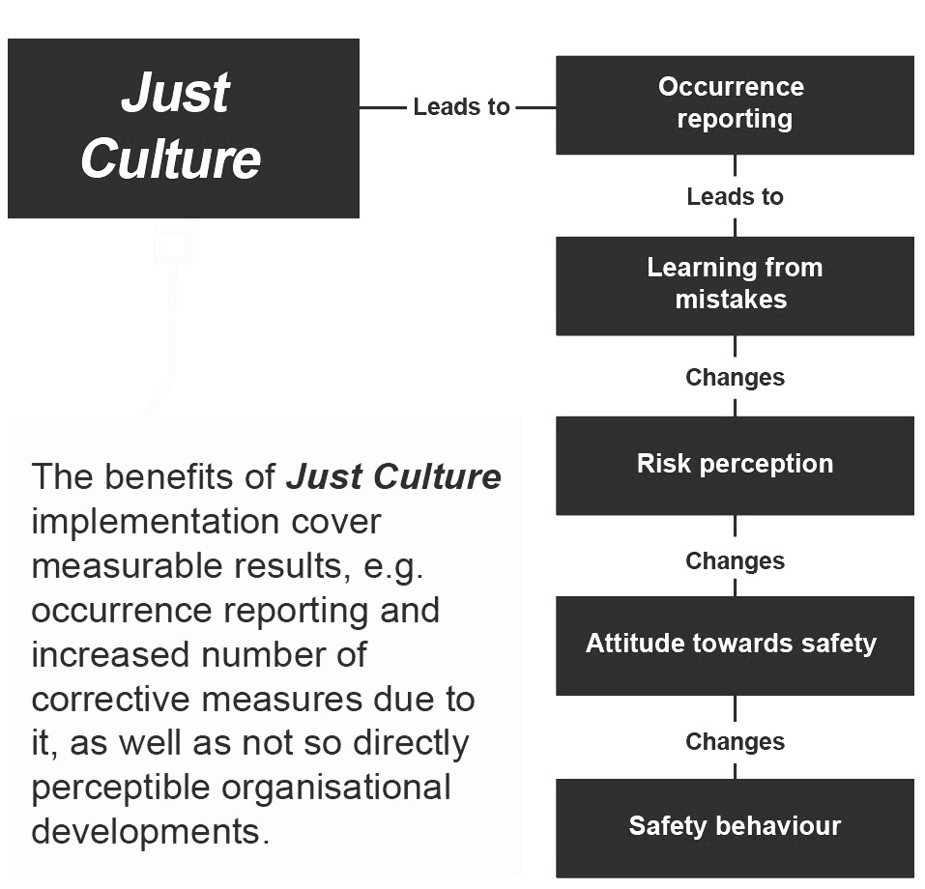

How does Just Culture help?

Slide 4
Why is it hard to build?
Fear of Repercussions: People may hesitate to admit mistakes if they fear punishment.
Old Habits Die Hard: Many organizations are stuck in a blame-heavy mindset.
Leadership Gaps: Without active support from leaders, these efforts often falter.

Slide 5

Cultural Roadblocks
Change is Tough: Teams are naturally resistant to letting go of “this is how we’ve always done it.”
Shifting Mindsets: It’s not just about actions but changing how people think about accountability.

Slide 6

Communication Challenges
Poor communication can lead to misunderstandings and mistrust.
Feedback loops might exist on paper but not work effectively in practice.
Transparency is hard to achieve without deliberate effort.

Slide 7

Pressure on Teams
In fast-paced DevOps environments, the pressure to deliver quickly often takes priority over reflection and learning.
High workloads can lead to burnout, which undermines psychological safety

Slide 8
How to overcome?
Lead by Example: Leaders should embody and advocate for a Just Culture.
Safe Spaces: Introduce anonymous reporting systems and open channels for communication.
Invest in Training: Equip teams with the tools and knowledge to adopt this mindset.

Slide 9

References:
https://humanisticsystems.com/2023/10/18/why-is-it-just-so-difficult-barriers-to-just-culture-in-the-real-world/
https://www.eans.ee/sites/default/files/inline-images/Just%20Culture-eng.PNG
https://pmc.ncbi.nlm.nih.gov/articles/PMC9884909/

